Slide 1
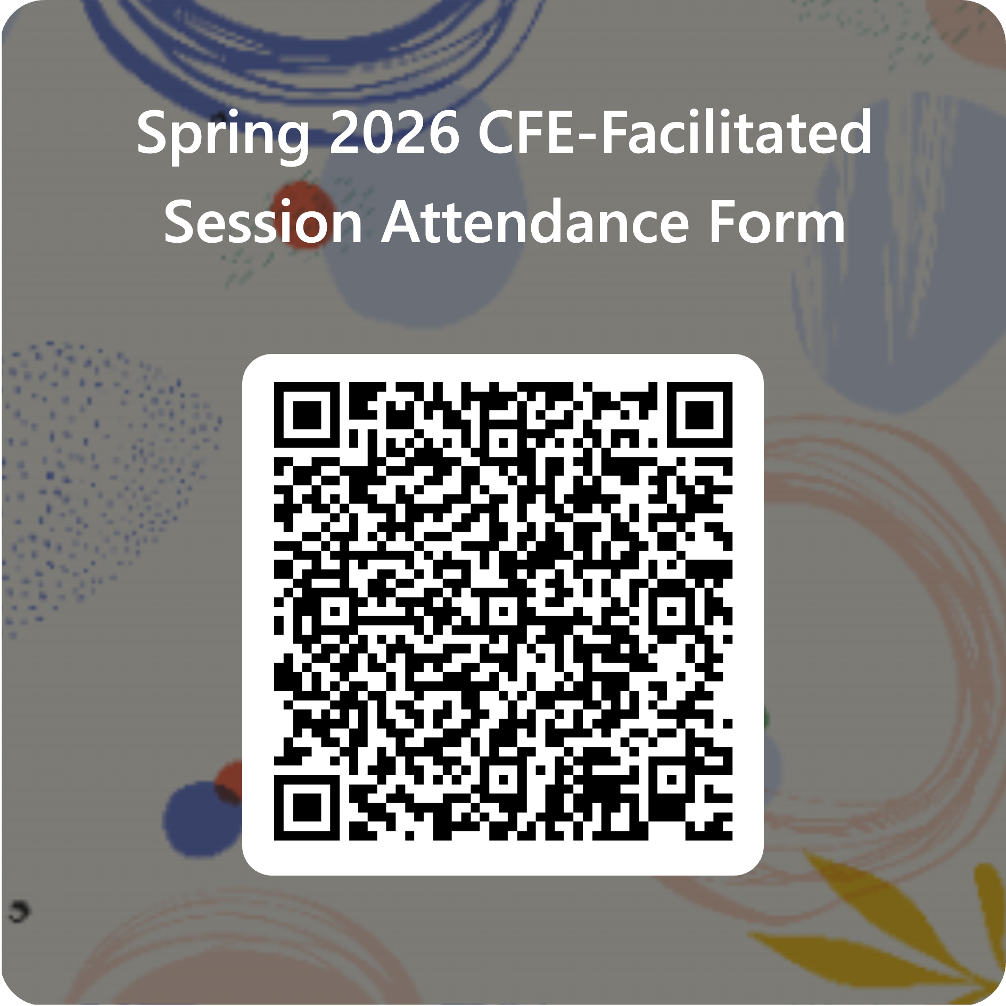
Please complete the CFE attendance form
https://forms.office.com/r/xQbbFvTtK3
Notes:
Please complete the attendance form: https://forms.office.com/r/xQbbFvTtK3

Slide 2
Making Your Word Documents Accessible
Caitlin Bartholic, February 13th, 2026

Slide 3
At the end of this workshop you will be able to:
Make quick improvements to your documents by fixing common issues with headings, color contrast, alt text, hyperlinks, and font readability.
Edit Microsoft Word documents using simple accessibility techniques that make your content clearer and easier for all learners to navigate.
Apply practical, everyday accessibility habits you can use immediately in your teaching, communication, or course materials.
Notes:
You have access to video tutorials I created for everything we will cover in this workshop today, as well as a document that you can access in your “Just In Time” resources.

Slide 4
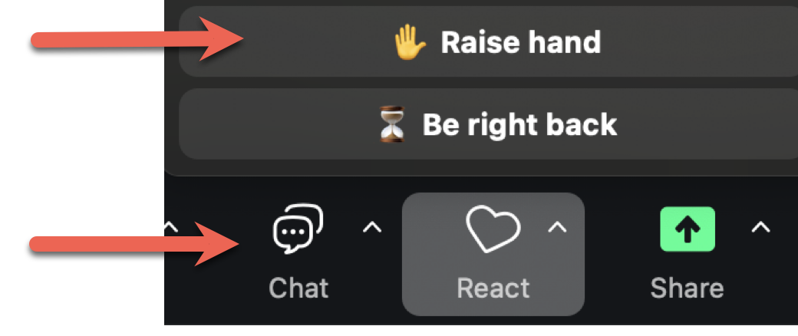
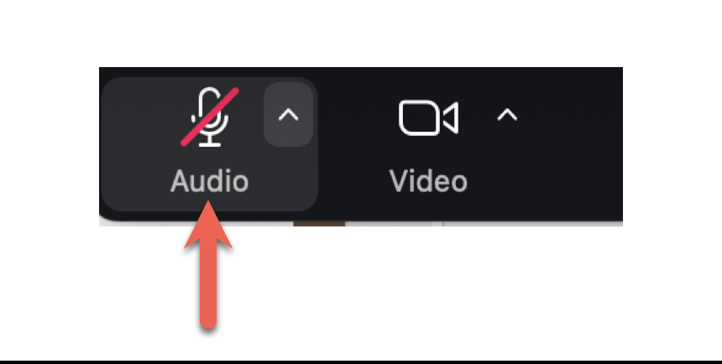
Ways to interact during the workshop
Select the “raise hand” icon on Zoom
Enter questions/comments in the chat
Unmute and talk

Slide 5
Warm-Up Poll
Use the Zoom poll, or enter the number in the chat that corresponds to your answer:
“What’s your current comfort level with digital accessibility?”
1. Very comfortable
2. Somewhat comfortable
3. New to this

Slide 6
Why WCAG?
(Web Content Accessibility Guidelines)
Equity & Universal Design - better for all learners, not only those with disabilities.
Student/Learner Experience - smoother navigation, reduced cognitive load, better retention.
Institutional Responsibility - WCAG 2.1 AA is the current compliance target for higher-ed digital environments.
Everyone should be able to access your incredible content!
WCAG Success Criteria in Plain English
Notes:
https://aaardvarkaccessibility.com/wcag-plain-english/
You will see WCAG Success Criteria with each new concept we cover today – you do not need to memorize these, but we are dropping a link in the chat to the “plain English” version of the WCAG 2.1 Guidelines and Criteria, which is not all encompassing but a great place to start when you’re digging deeper into making accessible digital content.

Slide 7
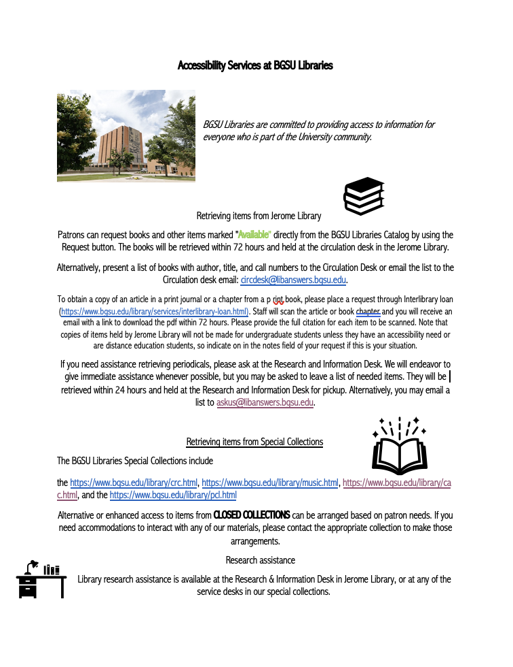
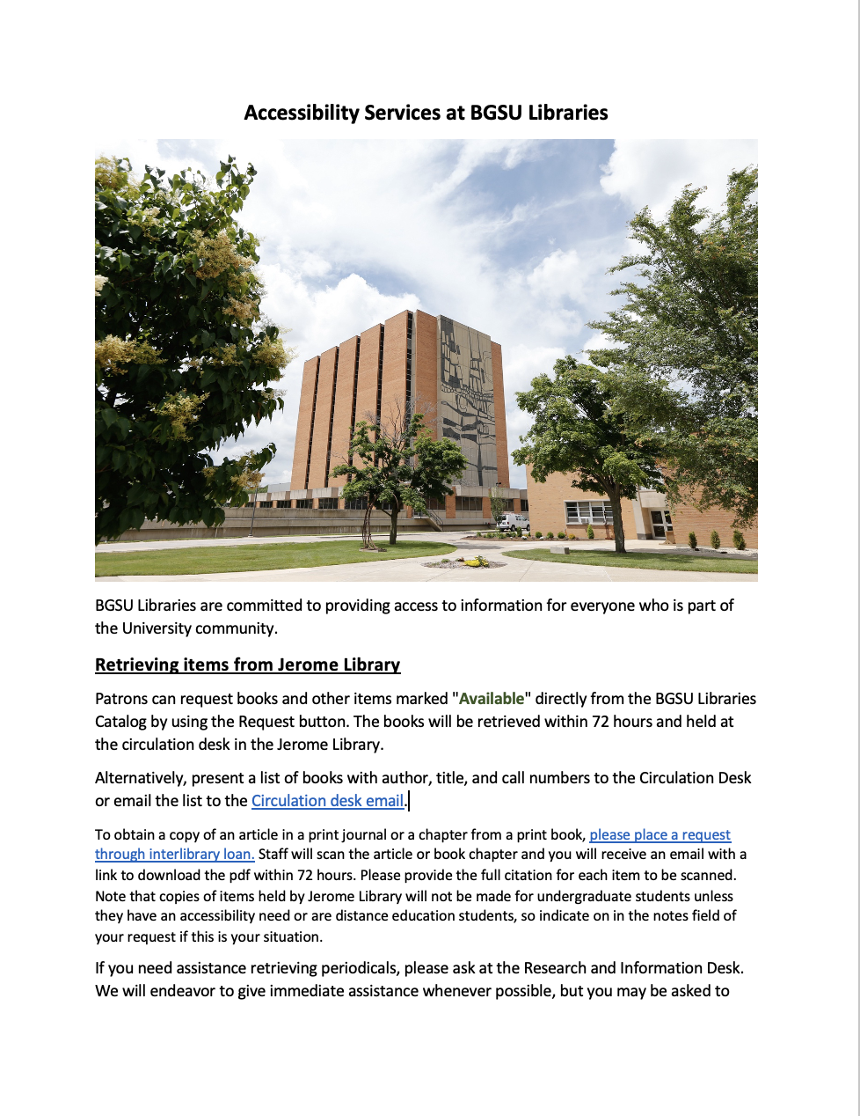
Which is easier to read?

Slide 8
Color Contrast
This is 1.08:1 Color Contrast
This is 2:1 Color Contrast
This is 3.4:1 Color Contrast
This is 4.54:1 Color Contrast
This is 7.5:1 Color Contrast
Key WCAG Success Criterion
1.4.3 Contrast (Minimum)
Normal Text: 4.5:1 ratio
Large text: 3:1 ratio
This is 1.08:1 Color Contrast
This is 2:1 Color Contrast
This is 3.4:1 Color Contrast
This is 4.54:1 Color Contrast
This is 7.5:1 Color Contrast

Slide 9
BGSU Brand Colors
White: FFFFFF
BGSU Teal: 1c626d
6.95:1
White: FFFFFF
BGSU Brown: 4f2c1d 12.27:1
BGSU Brown: 4f2c1d
BGSU Rose: e3a492 5.48:1
BGSU Tan Tint: eae1d8
BGSU Teal: 1c626d
5.38:1
BGSU Tan Tint: eae1d8
BGSU Brown: 4f2c1d 9.5:1
BGSU Brown: 4f2c1d
BGSU Tan: eae1d8 9.5:1
BGSU Brown: 4f2c1d
BGSU Coral: f37b6c 4.59:1
BGSU Brown: 4f2c1d
BGSU Seafoam:80baac 5.57:1
BGSU Brown: 4f2c1d
BGSU Gold: f5c163 7.41:1
Black text can also be used instead of BGSU brown text for better contrast.
Notes:
Here are some examples of using BGSU branded colors with acceptable color contrast.
These can go either way – foreground & background.
Some are better than others – if it looks difficult to read to you, don’t use it.

Slide 10
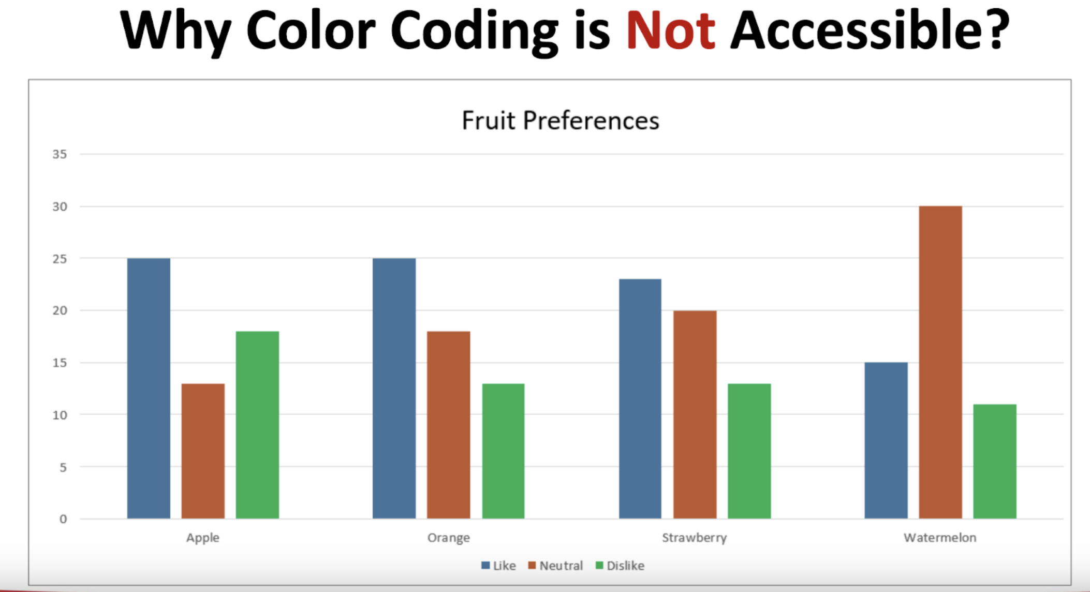
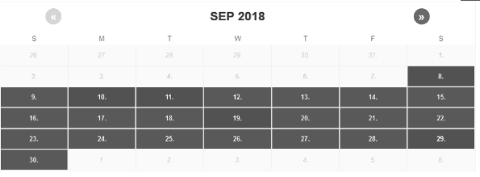
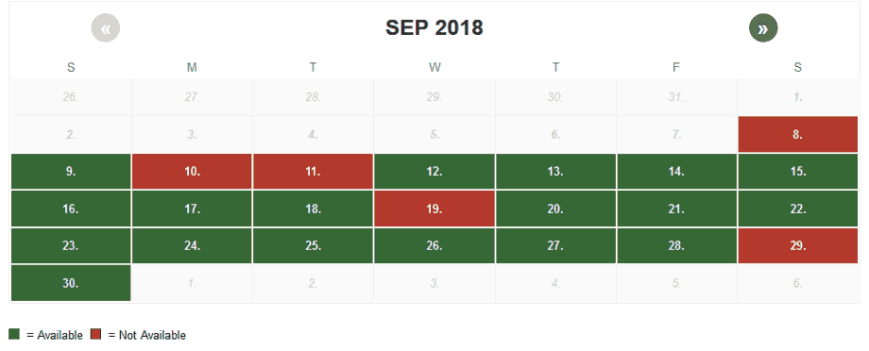
Color Contrast Key Points
Color alone cannot convey meaning (1.4.1 Use of Color)
Check contrast early when designing slides, documents, LMS pages
WebAIM Color Contrast Checker
Image 2 Source: WebAIM Accessible Images
Image 1 Source: Venngage “Convey Meaning Without Relying on Color”
Notes:
https://webaim.org/resources/contrastchecker/
Image 1 source: https://help.venngage.com/hc/en-us/articles/11013077501709-Convey-Meaning-Without-Relying-on-Color
Image 2 source: https://webaim.org/techniques/images/

Slide 11
Heading Hierarchy
Heading 1
Use “Heading 1” for the Title.
Heading 2
Heading 3
Paragraph Text
Key WCAG Success Criterion
1.3.1 Info and Relationships
Structure must be programmatically determinable (semantic headings,
not visual styling)
Heading 2
Heading 3
Paragraph Text
Only use “Title” if there is a separate cover page with duplicate Title.
Notes:
Headings need to be structured correctly within Word, not just by use of visual elements like bold, font size, etc.
Headings need to follow a consistent hierarchy, always beginning with Heading 1 and working numerically from there.
Screen readers do not always pick up “Titles” so only use “Title” if you have a cover page where the title is also listed.
Level 2 headings are main headings.
Level 3 headings are subheadings.

Slide 12
Heading Hierarchy Key Points
Headings create structure, not just visual formatting
Must follow sequential order: H1 -> H2 -> H3
Benefits:
Screen reader navigation
Cognitive ease for all users
Clear outline for editing and writing

Slide 13
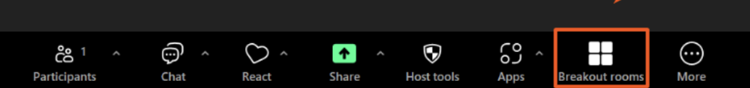
Breakout Room 1
Breakout Room 2
Open your own document and
experiment with heading hierarchy.
Caitlin Bartholic
Download the provided demo document and experiment with heading hierarchy.
Chelsea Chandler

Slide 14



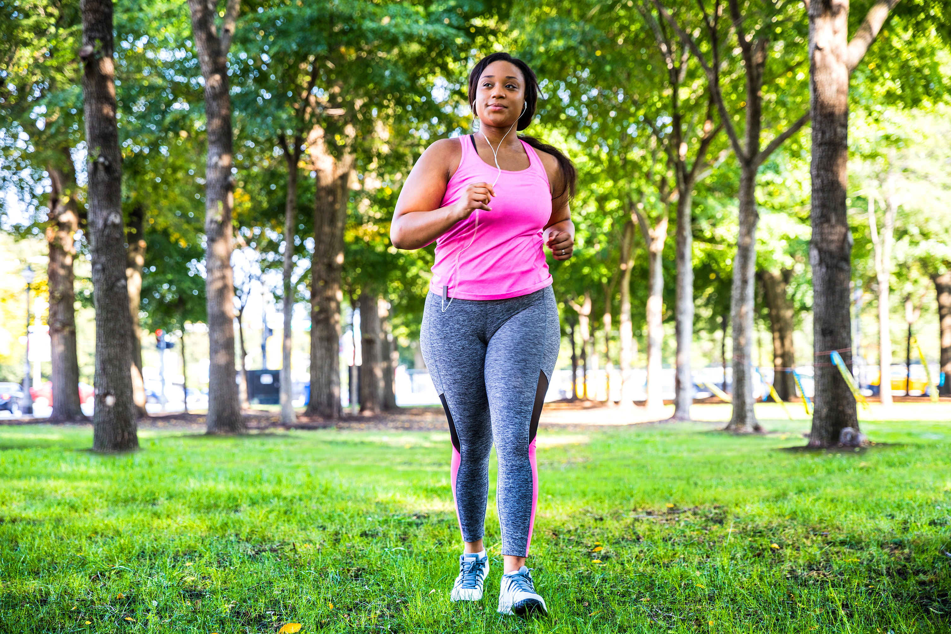
Alternative Text
Key WCAG Success Criterion
1.1.1 Non-Text Content
All meaningful images require text alternatives; decorative images must be marked as such
100-150 characters
25-30 words
(Graphs and charts may have more)

Slide 15
Alternative Text Key Points
  Provide alternatives for meaningful images.
  Dependent on context
  Describe purpose, not appearance.
  What is this?
  Why is it here? (Pedagogical intent)
  What would a learner miss if it wasn’t there?
WebAIM Alt Text Context Practice
Notes:
Example on WebAIM: https://webaim.org/techniques/alttext/

Slide 16
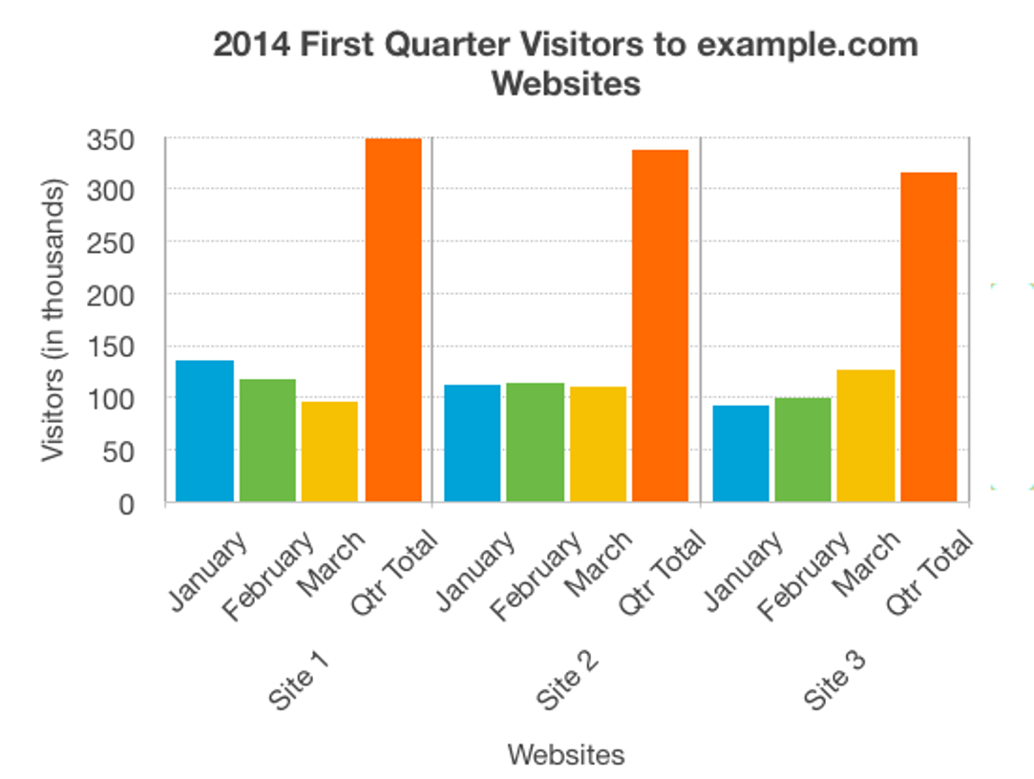
Alternative Text – Graphs & Charts
Alt Text: Bar graph showing 2014 first quarter visitors to example.com by month
Best Practice: Provide an accessible table or list as an alternative.
2014 First Quarter visitors per site (in thousands)
Period | Site 1 | Site 2 | Site 3
January | 135 | 112 | 92
February | 117 | 114 | 99
March | 96 | 111 | 126
Quarter Total | 348 | 337 | 308
Figure 1/Image Description: The chart shows the website hits for the first quarter of 2014. It shows that Site 1 has more visitors than either of the other sites, but the number of visitors is decreasing. Site 2 has a fairly constant number of visitors, while for Site 3 page hits are increasing month on month.
Image Source: W3.org Complex Images
Notes:
https://www.w3.org/WAI/tutorials/images/complex/

Slide 17
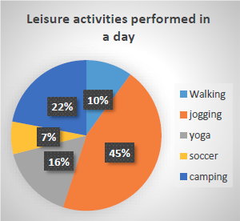
Alternative Text – More Graphs & Charts
Alt Text: Pie chart displaying the percentage of various leisure activities performed by respondents in a day.
Figure 2/Image Description: Jogging occupies 45 percent, camping occupies 22 percent, yoga occupies 16 percent, walking occupies 10 percent, and soccer occupies 7 percent.
Image Source: Diagram Center
Notes:
http://diagramcenter.org/specific-guidelines-e.html#53

Slide 18

Padlet Practice
Label three images:
One should be marked as decorative.
One is a photo that needs alt text.
One is a chart that needs alt text.
Notes:
You will see THREE images. One will need to be labeled as “Decorative” so it is ignored by screen readers. One is a photo that needs appropriate alt text considering the given context, and one is a chart that needs alt text, and you can decide if you would give it a longer image description, or create a table or list as an alternative to the image.
This is anonymous so don't be afraid to try! I purposefully chose images that are not likely subject matter for any of you to really get us out of our comfort zone and start thinking in ways that will help us create accessible content.
https://padlet.com/caitlinbartholic/adding-alternative-text-28hmg38uqlr0vlnh

Slide 19
Descriptive Hyperlinks
Key WCAG Success Criterion
2.4.4 Link Purpose (In Context)
The purpose of a link must be clear from its text alone (or its surrounding context).
Notes:
Links must be clear both in and out of context.

Slide 20
Descriptive Hyperlinks Key Points
Avoid non-informative text:
“Click here”
“Read more”
Raw URLS (https://www.thisisareallylonglinkforascreenreader183.com)
Descriptive links communicate destination or action.
Example:
“Download the Biology Syllabus” vs “Click Here”
Notes:
Avoid non informative text – screen readers will read these as they appear.

Slide 21
Fonts & Readability – Institutional Best Practices
Use readable, accessible Sans Serif fonts: Calibri, Aptos, Verdana
Avoid decorative fonts for paragraph text
Avoid all caps, tight spacing, justified text
Left align text when possible
Headings in Word should be 20-24pt, Text should be 12-14pt
Ensure adequate font size in slides (20-22pt)
This text is size 26 This text is size 26
This text is size 22 This text is size 22
This text is size 14 This text is size 14

Slide 22
Putting it All Together
Start with headings (structure first)
Check hyperlinks (descriptive text)
Evaluate images (add/mark alt text)
Review contrast (use WebAIM checker)
Final pass (readable font + spacing)
Notes:
Start with heading structure – this will also update your Navigation Pane and help you navigate your document
Check hyperlinks for descriptive text, and check for errors like leaving in a parenthesis or period.
Evaluate images and add alt text, and only use images with good color contrast
Review contrast using the WebAIM checker (bookmark it!)
Final pass – check for readability. Font, spacing, cognitive load, etc.

Slide 23
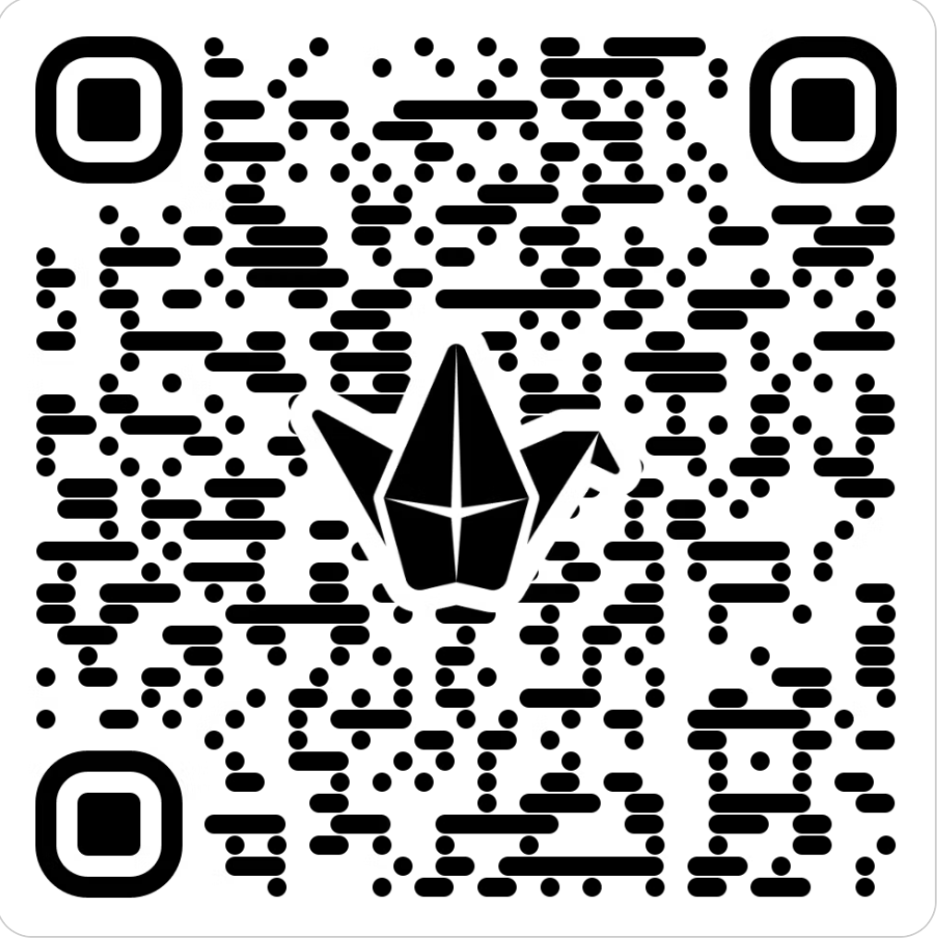
Padlet Reflection and Q & A
What is one accessibility practice you feel comfortable beginning to implement after today’s session?
What is one question you still have about implementing accessibility into your digital content?
Notes:
https://padlet.com/caitlinbartholic/accessibility-wrap-up-ayensn8ezjmi6den

Slide 24

Please complete the
CFE reflection form
Thank You!
Caitlin Bartholic
caitlin.bartholic@gmail.com
https://forms.office.com/r/GFEth438Sg
Notes:
https://forms.office.com/r/GFEth438Sg

